Slide 1
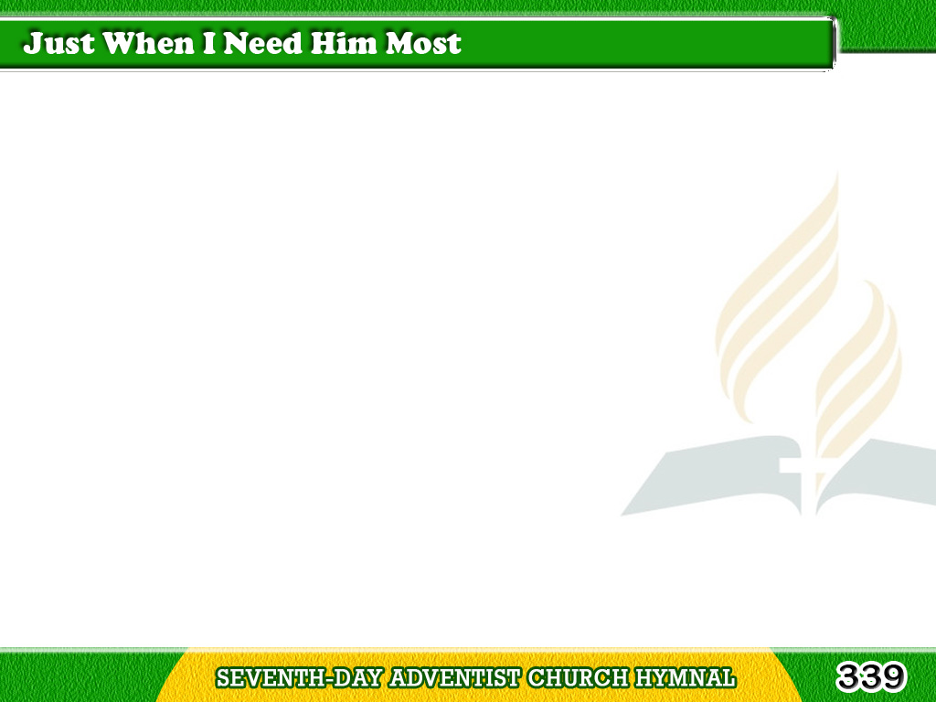
1/4
Just when I need Him,
Jesus is near,
Just when I falter,
just when I fear;
Tagalog
Version

Slide 2
1/4
Ready to help me,
ready to cheer,
Just when I need Him most.
Tagalog
Version

Slide 3
1/4
Chorus
Just when I need Him most,
Just when I need Him most;
Jesus is near to comfort
and cheer,
Just when I need Him most.
Tagalog
Version

Slide 4
2/4
Just when I need Him,
Jesus is true,
Never forsaking,
all the way through;
Tagalog
Version

Slide 5
2/4
Giving for burdens
pleasures anew,
Just when I need Him most.
Tagalog
Version

Slide 6
2/4
Chorus
Just when I need Him most,
Just when I need Him most;
Jesus is near to comfort
and cheer,
Just when I need Him most.
Tagalog
Version

Slide 7
3/4
Just when I need Him,
Jesus is strong,
Bearing my burdens
all the day long;
Tagalog
Version

Slide 8
3/4
For all my sorrow
giving a song,
Just when I need Him most.
Tagalog
Version

Slide 9
3/4
Chorus
Just when I need Him most,
Just when I need Him most;
Jesus is near to comfort
and cheer,
Just when I need Him most.
Tagalog
Version

Slide 10
4/4
Just when I need Him,
He is my all,
Answering when upon
Him I call;
Tagalog
Version

Slide 11
4/4
Tenderly watching lest
I should fall,
Just when I need Him most.
Tagalog
Version

Slide 12
4/4
Chorus
Just when I need Him most,
Just when I need Him most;
Jesus is near to comfort
and cheer,
Just when I need Him most.
Tagalog
Version

